Slide 1
Using Prediction to enhance remote robot supervision across time
ROBERT r. Burridge and Kimberly A. Hambuchen

Slide 2
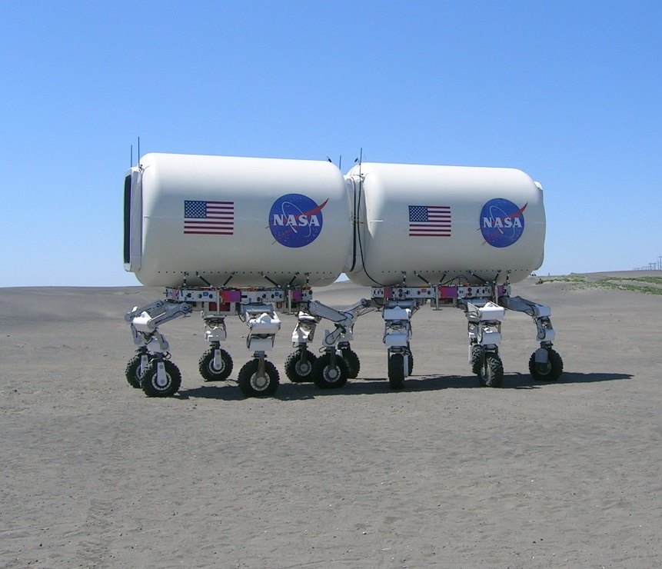
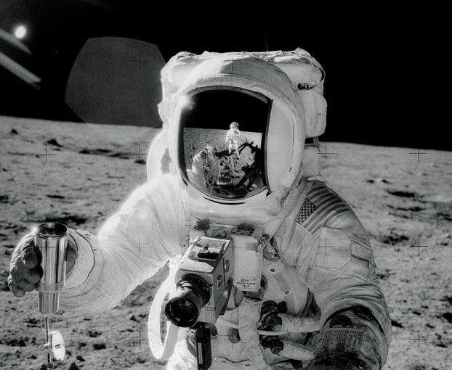
http://apod.nasa.gov/apod/ap060121.html; Charles Conrad Apollo 12
Plans to establish a permanent base on the moon by 2020 will require multiple robotic systems.
Such as ATHLETE, Centaur, Chariot, K-10, and SCOUT
Landing site selection, base site selection, and construction will require the aid of robotic systems.
http://science.nasa.gov/science-news/science-at-nasa/2009/08apr_apolloupgrade/

Slide 3
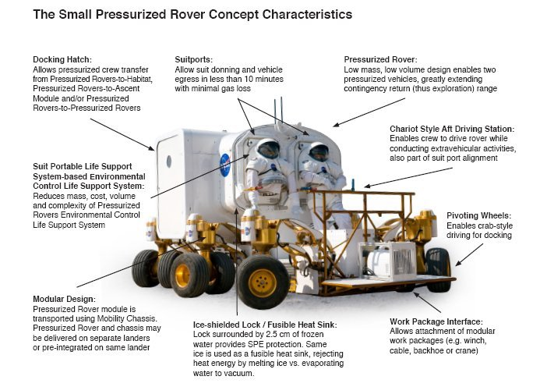
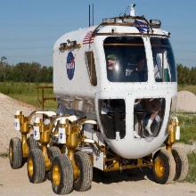
http://er.jsc.nasa.gov/seh/Chariot/Chariot.htm
http://er.jsc.nasa.gov/seh/Chariot/Chariot.htm
These robotic systems will be designed with both automated and teleoperated control capabilities.
Is this a necessary and/or desirable design feature for all future extra-terrestrial exploration and reconnaissance?
The teleoperated capabilities may be necessary since the robotic systems will arrive prior to human occupation and the robotic systems will be required to perform tasks beyond current capability of autonomous systems
Which include unstructured and under-constrained activities.

Slide 4
Teleoperation will be available locally to those humans that arrive on the moon as well as available to the Earth bound. With an Earth bound operator in control, the lunar-based humans will be free to perform other tasks.
Human-Robot Interaction: lunar-based human and robots, lunar-based robot and remote supervisor.
The expected time delay is between 5 and 10 seconds from the Earth to the moon and back again.
Would conducting experiments where the time delay was varied in this range significantly alter the results ?

Slide 5
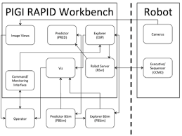
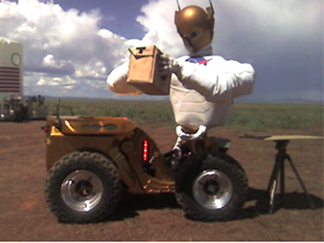
The Predictive Interactive Graphical Interface (PIGI) is designed to assist in the supervision of remote robotic systems.
Initially developed for use with Centaur to investigate issues with time delay.
The task queueing aspect of the PIGI enables operators to reduce robotic system idle time.
Operators were able to interleave driving and non-driving tasks.
Robot behavior prediction capability of the PIGI allows the supervisor to modify which tasks are queued based on the modeled predictions.
http://ntrs.nasa.gov/archive/nasa/casi.ntrs.nasa.gov/20120008818.pdf
http://robonaut.jsc.nasa.gov/R1/field-ops/desert06.asp

Slide 6
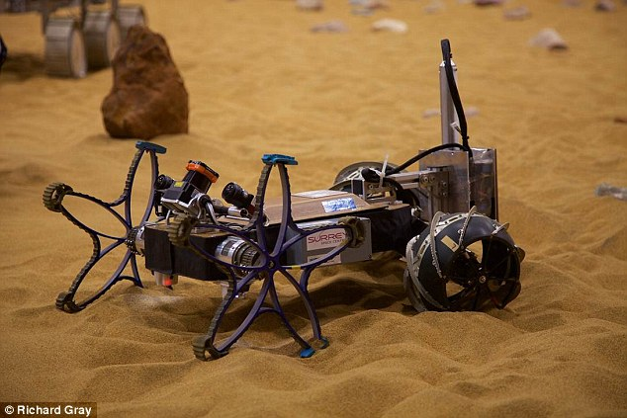
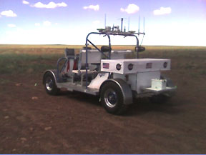
http://www.dailymail.co.uk/sciencetech/article-2823592/Nasa-s-rover-pal-Small-robot-scout-rocky-terrain-ahead-prevent-accidents.html
PIGI
Task Queues
Task objects contain unique IDs, command type, and parameters not just a stream of positions or velocities.
Robot Server
PENDING, ACTIVE, SENT, and COMPLETED task queues.
Prediction
Purpose of the Predictor is to inform the supervisor of the anticipated activity of the robot from its most recently reported state to the completion of the final command on the SENT queue.
Exploration
Expected results of uncommitted commands.
Visualization
Uses Enigma for simulation and animation.
http://robonaut.jsc.nasa.gov/R1/field-ops/desert06.asp

Slide 7
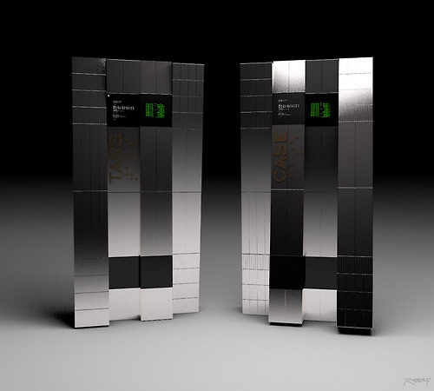
Commands
Relative versus absolute. Goal location of (X, Y, Angle).
GPS positioning for space bound robots? Is this appropriate?
Central Command and RAPID Sequencer
CORBA based network protocol communication interfaces
Time Delay
Static 10 sec internal time delay. Was the actual time delay equivalent to the intended time delay?
https://wtalabi.files.wordpress.com/2014/11/tars.jpg

Slide 8
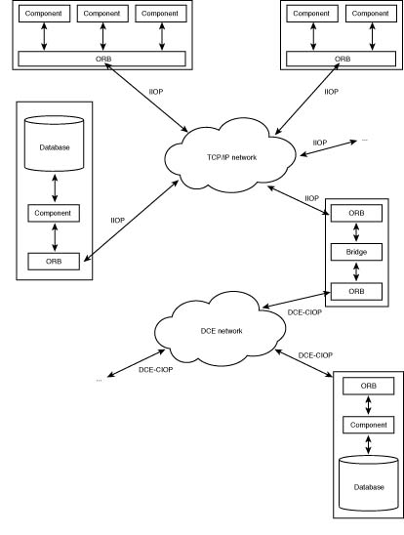
Common Object Request Broker Architecture
CORBA and the Networking Model
Essentially, CORBA applications are built on top of GIOP-derived protocols such as IIOP. These protocols, in turn, rest on top of TCP/IP, DCE, or whatever underlying transport protocol the network uses. CORBA applications aren't limited to using only one of these protocols; an application architecture can be designed to use a bridge that would interconnect, for instance, DCE-based application components with IIOP-based ones. You can see, then, that rather than supplant network transport protocols, the CORBA architecture creates another layer--the inter-ORB protocol layer--which uses the underlying transport layer as its foundation. This, too, is a key to interoperability between CORBA applications, as CORBA does not dictate the use of a particular network transport protocol.

